Slide 1
SHA-1 / VGA / UART
ECE3300
12/16/22
Andrew Khechatourian, Charles Tran,
Eric Tran, Luke Yu

Slide 2
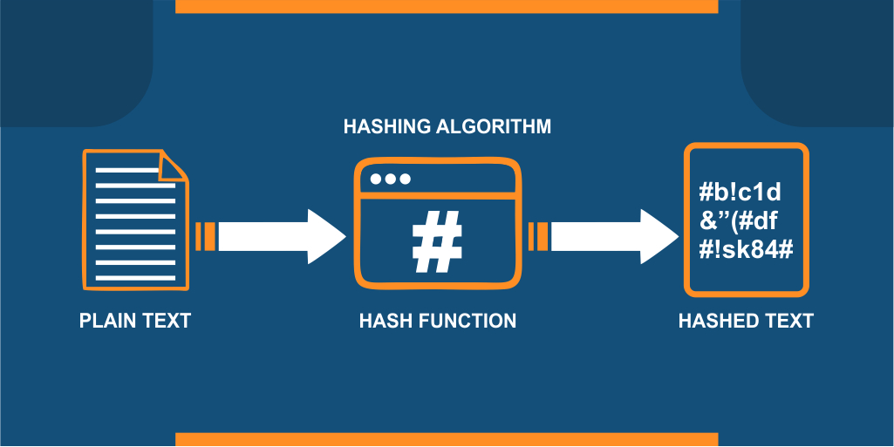
HASH FUNCTION
Process of scrambling a piece of data beyond recognition
Useful and appear in almost all information security applications
Avoid Collisions
Notes:
Done By Luke Yu

Slide 3
SHA-1
Message Size = 2^64 bits
Message Block Size = 512 bits
Word Size = 32 bits
Message digest = 160 bits

Slide 4
SHA-1 Preprocessing:
Padding the Message
Ensure the message is a multiple of 512 bits
Parsing the padded message into 512-bit blocks
Represented as 16 32-bit words or 8-bit Hex words
Setting Initial Hash Values
Initial Hash Values based off SHA-1 Implementation

Slide 5
SHA-1 Preprocessing: (cont.)
Padding the Message
End up with 512 bit message blocks regardless of input
Example Input: ‘abc’
ASCII Binary Code: 01100001 01100010 01100011
ASCII Hex Code: 61 62 63
‘a’ ‘b’ ‘c’
Notes:
Andrew

Slide 6
SHA-1 Preprocessing: (cont.)
After input, we pad one bit and use this formula: k=448-(l+1), to obtain the amount of zeros we need to pad to obtain 512 bits
l represents the length of the message: ‘abc’ = 3 8-bit words= 3 x 8 = 24 bits
+1 accounts for appending one bit with a ‘1’
k represents the amount of zeros needed to pad the rest of the 512-block
ASCII Binary Input:
01100001 01100010 01100011 10000000 00000000 … 00000000
‘a’ ‘b’ ‘c’
l = 24 bits
Append with ‘k’ Amount of zeros
In this case:
k = 448 - (24+1) = 423
Notes:
Andrew

Slide 7
SHA-1 Preprocessing: (cont.)
The last 64 bits of the block are always saved to hold the length of the message itself
In this example since we had 3 characters, that gives us a length of 24 bits
In Binary this is represented as ‘11000’, since we don’t use all 64 bits in this case we append the rest of the bits as ‘0’
ASCII Binary Input:
01100001 01100010 01100011 10000000 … … 00000000 00011000
Bits: 24 +1 423 64 = 512 bits
Length of message
in binary
Input: ‘abc’
Padding ‘0’s
Notes:
Andrew

Slide 8
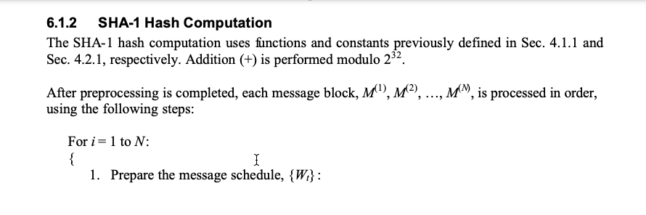
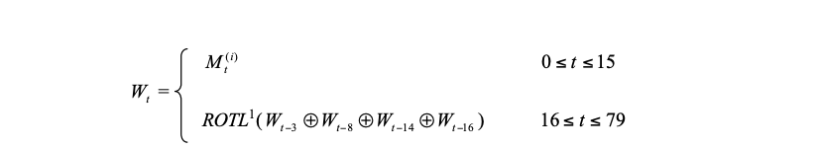
Computation:
Notes:
Luke

Slide 9
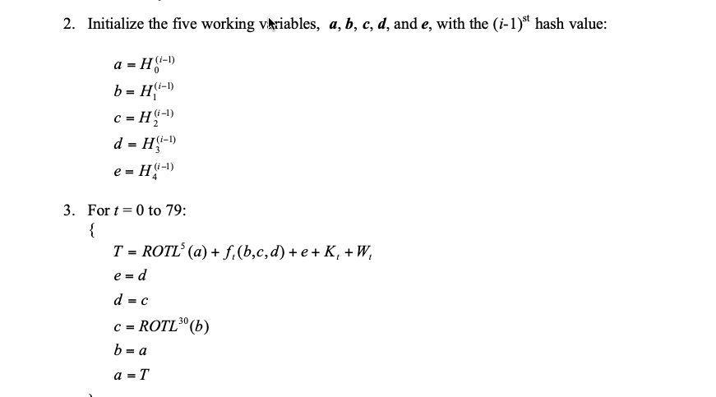
Notes:
Luke

Slide 10
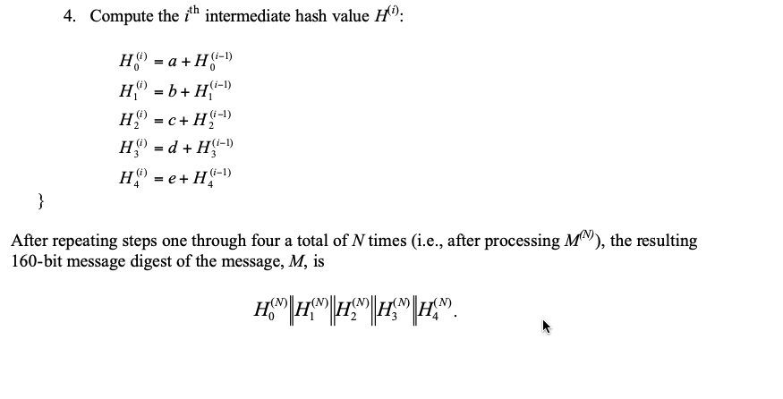
Notes:
Luke

Slide 11
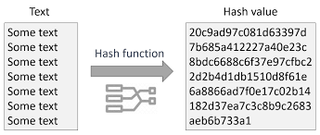
Summary: SHA-1
Sha-1 is a member of the Sha family
Sha-1 is compromised but still useful for developing new Secure Hash Algorithm

Slide 12
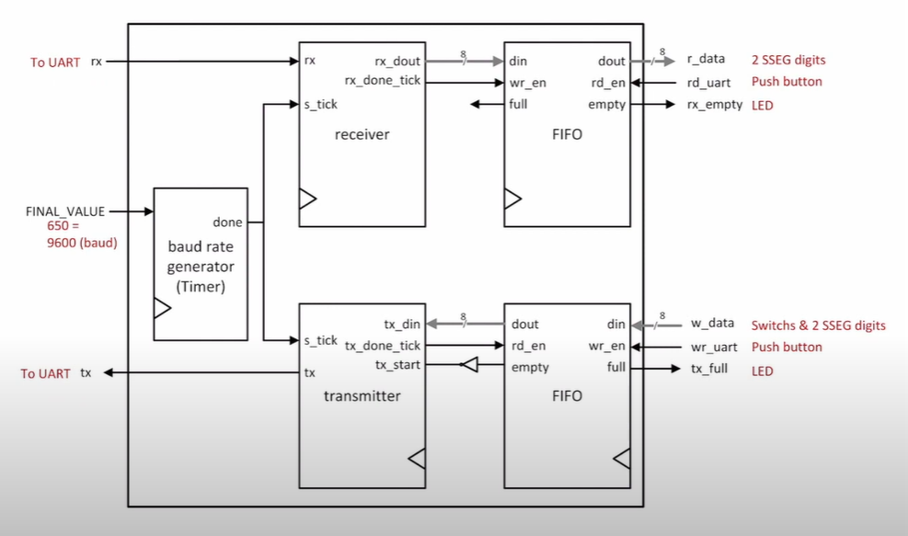
UART
Universal asynchronous
receiver/ transmitter
uses two wires to transmit
and receive data in both
direction.

Slide 13
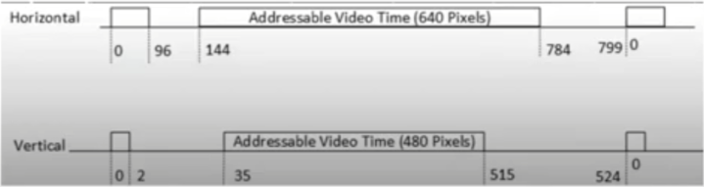
VGA
Video Graphics Array displays onto a monitor by outputting RGB in
horizontal and vertical axises.
Notes:
Done by Charles Tran

Slide 14
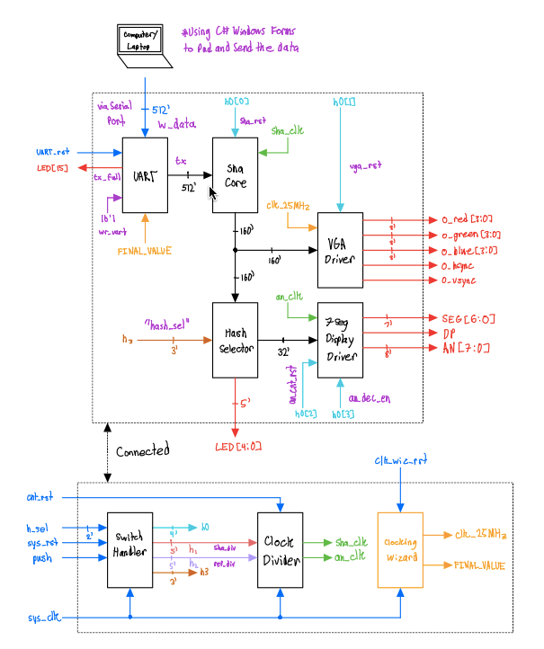
Schematic:

